Slide 1
Open Targets Platform and Genetics, web resources for drug discovery
STORM Therapeutics
April 30th 2019
Denise Carvalho-Silva, PhD
EMBL-EBI | Open Targets
Wellcome Genome Campus
United Kingdom

Slide 2
This session 13:00-17:00
Introduction to the partnership
Open Targets Platform: presentation + live demos
Open Targets Platform: exercises
Coffee break → 15:30
Open Targets Genetics : presentation + live demo
Feedback survey and wrap up

Slide 3
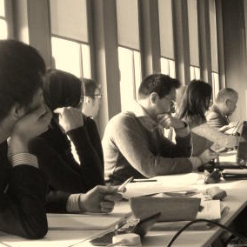
Aims
What is Open Targets?
What are the main Open Targets resources?
How can I make the most of these resources?
How to get in touch for help
and suggestions

Slide 4
Workshop materials
Presentation slides:
Coursebook with exercises
https://tinyurl.com/slides-STORM
https://tinyurl.com/exercises-STORM

Slide 5


Slide 6
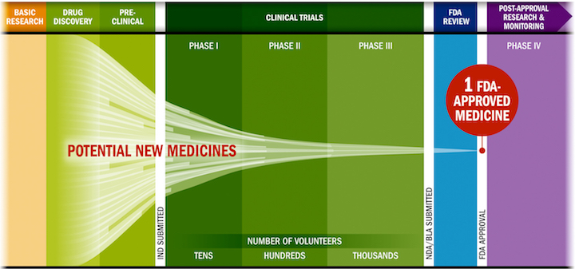
Drug discovery: some challenges
Lengthy, costly, low success rate, HIGH ATTRITION RATES
Source: PhRMA adaptation based on Tufts CSDD & School of Medicine, and FDA
Notes:
PhRMA (
Lengthy: Drug discovery from start (idea) to finish (market) can take up to 20 years.
Costly: specially from clinical trials when human subjects are tested (volunteers or suffering from the condition)
Compounds drop out along the drug discovery journey → low success, high attrition

Slide 7
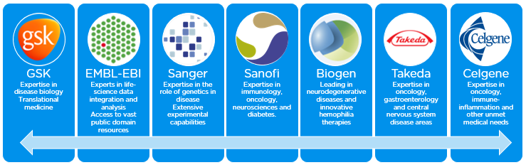
Open Targets
A partnership to transform drug discovery through the systematic identification and prioritisation of targets
Founding partners
2018
2016
2017
2018
https://www.opentargets.org
Notes:
A shared vision to create a partnership to transform drug discovery through systematics target ID and prioritisation.
From that idea Open Targets (formerly CTTV) was started to combine the world class functional genomics expertise at Sanger with the EBI‘s excellence in bioinformatics and computational biology and the industry expertise of GSK and now Biogen as well with the aim to find out all that‘s important about a target before starting the drug development pipeline.
Thereby the pipeline would be filled with validated and valid targets with a much improved odds ratio for success.

Slide 8

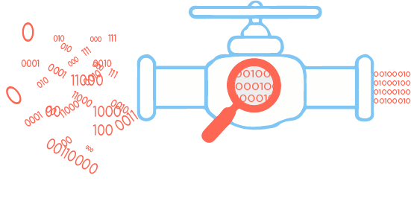





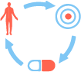





Virtuous cycle in Open Targets
Public data
Experimental projects
Bioinformatics projects
DATA
GENERATION
DATA
INTEGRATION
Therapeutic hypothesis
https://www.targetvalidation.org
https://genetics.opentargets.org
Notes:
Target ID and prioritisation knowledge cycle.
Our research focusses on data generation, data integration, and enabled data access
Our research is connected as we provide the tools to generate hypothesis and explore them experimentally
We focus primarily on oncology, immunology (including IBD) neurodegeneration with some experiments in other areas or across diseases

Slide 9
Data generation: Open Targets
Some examples
Organoid knockouts (CRISPR-Cas9) - gut epithelium
IL22 pathway to treat IBD?
Wellcome Sanger Institute, GSK, University of Cambridge
Alzheimer’s and Parkinson’s
CRISPR/Cas9 screens, iPS cells
Wellcome Sanger Institute, Biogen, Gurdon Institute
> 1,000 cancer cell lines + biomarkers + tractability
RNASeq, CRISPR/Cas9 screens
Wellcome Sanger Institute, GSK and EMBL-EBI
www.opentargets.org/science/

Slide 10
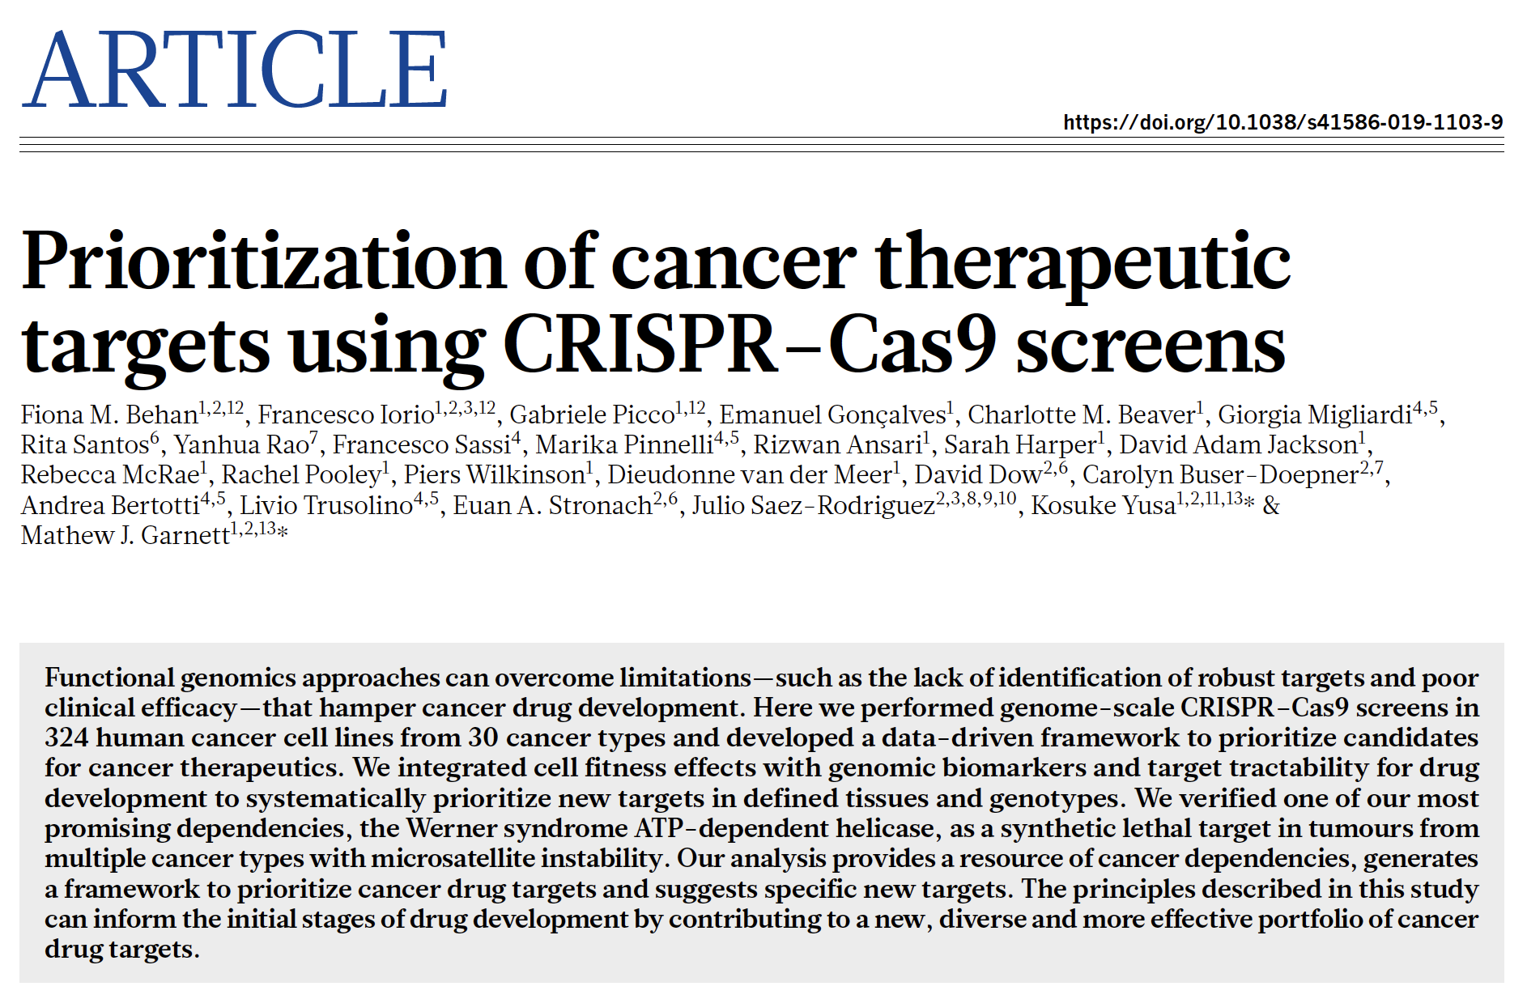

Data generation: Oncology

Slide 11
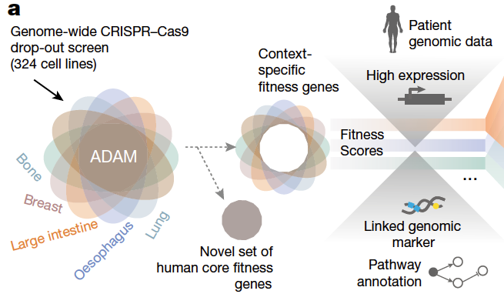
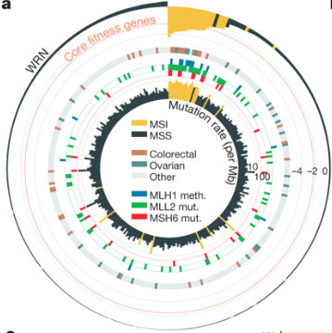
Behan et al (2019)
WRN sustains in vivo growth in:
colorectal
ovarian
endometrial
gastric
New candidate target for tumours with MSI (WRN antagonists)

Slide 12
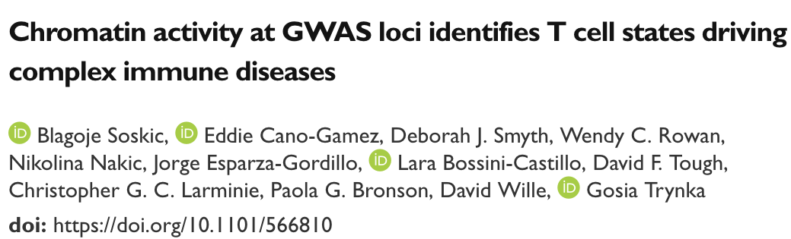
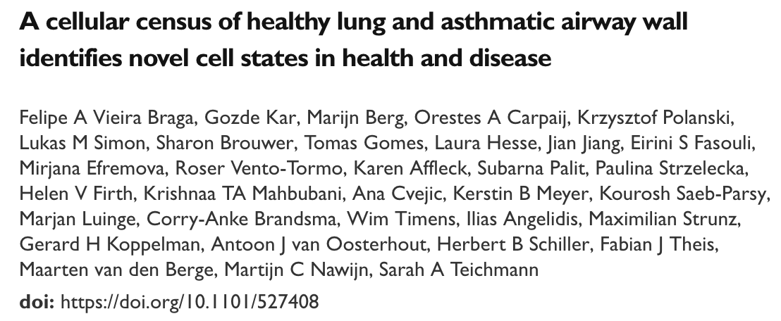
Open Targets preprints: more new data

Slide 13
Data integration: Open Targets
Open Targets Platform | Open Targets Genetics
Dec 2015 | Oct 2018
www.targetvalidation.org | genetics.opentargets.org
Targets, diseases and drugs | Variant, targets and diseases
Score that synthesises all evidence for T-D | Score that connects T-D via functional evidence
Rare and common diseases | Common diseases, other traits

Slide 14
Data integration: Open Targets
Open Targets Platform | Open Targets Genetics
Dec 2015 | Oct 2018
www.targetvalidation.org | genetics.opentargets.org
Targets, diseases and drugs | Variant, targets and diseases
Score that synthesises all evidence for T-D | Score that connects T-D via functional evidence
Rare and common diseases | Common diseases, other traits

Slide 15
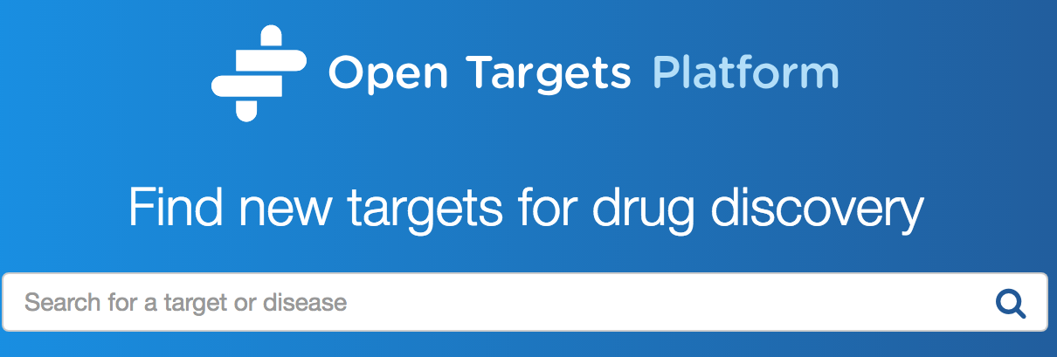
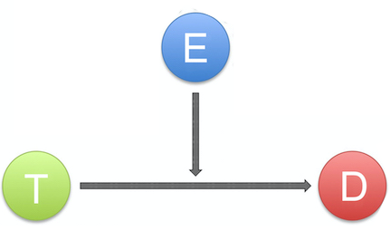
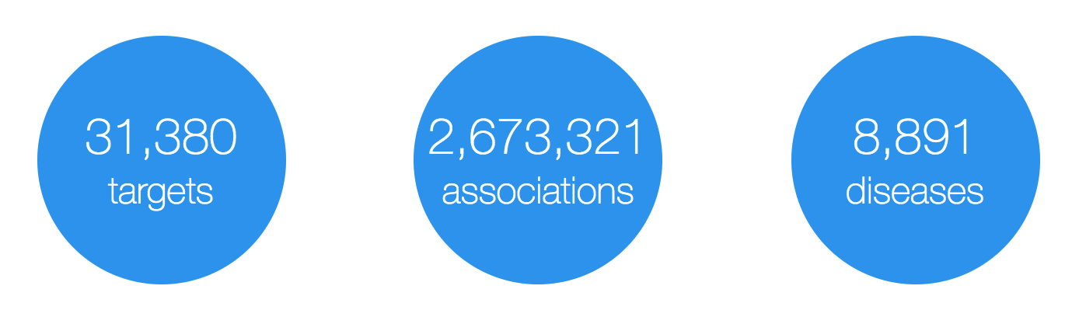
Evidence
https://www.targetvalidation.org
Target
Disease

Slide 16
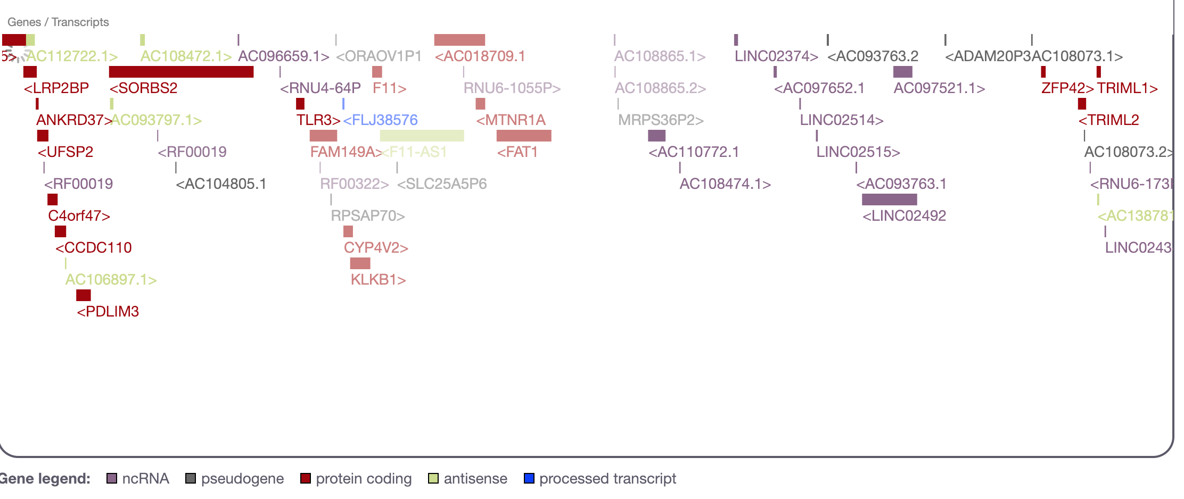
What is a target?
28K
targets
Examples
https://www.targetvalidation.org/target/ENSG00000255248
https://www.targetvalidation.org/target/ENSG00000175482?view=sec:genome_browser
Notes:
HGNC names e.g. DMD (synonyms)
Ensembl Gene IDs e.g. ENSG00000105641
UniProt IDs e.g. P15056
Non-coding genes e.g. MIR100HG

Slide 17
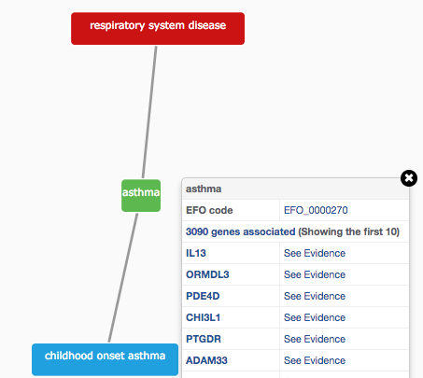
How do we describe our diseases?
Modified version of Experimental Factor Ontology (EFO)
Controlled vocabulary (Coeliac versus Celiac)
Hierarchy (relationships)
Promotes consistency
Increases the richness of annotation
Allow for easier and automatic integration
10K
diseases
Notes:
The choice of our disease ontology was EFO. It is cross-referenced against DO, OMIM, HP, MP, MONDO as well

Slide 18
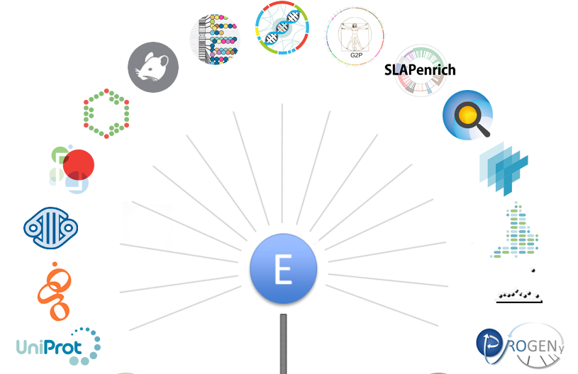
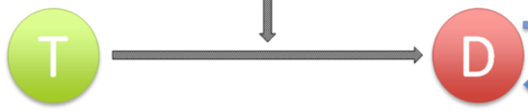
Evidence for our T-D associations
https://docs.targetvalidation.org/data-sources/data-sources
Notes:
Evidence: sequence (SNPs, mutations, germline and somatic curated at the DNA or protein level), differential mRNA expression, sentences from research papers, drug information, pathways affected by pathogenic mutation, animal models (https://github.com/opentargets/json_schema)

Slide 19
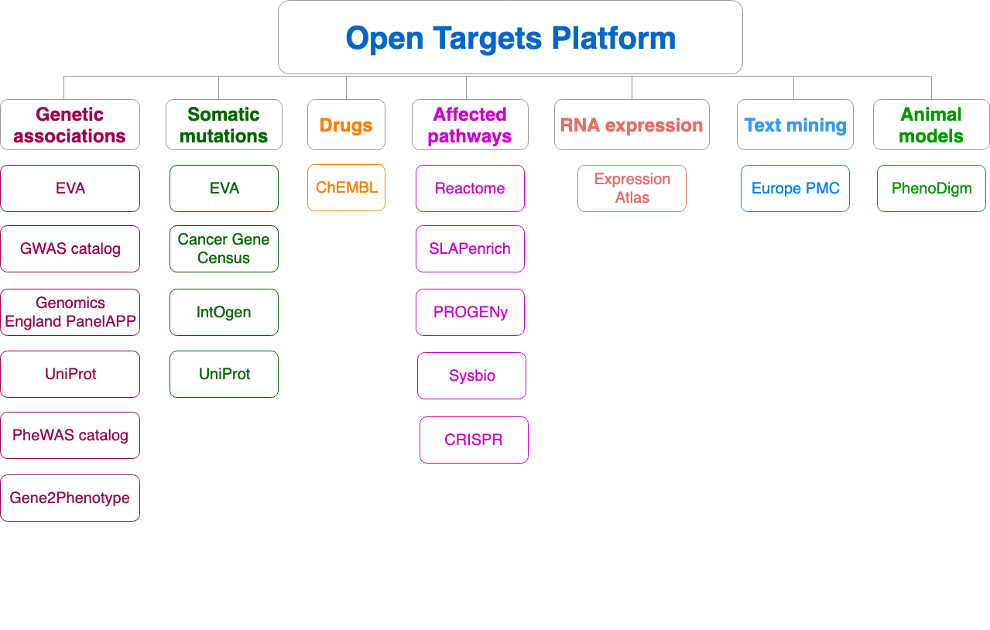
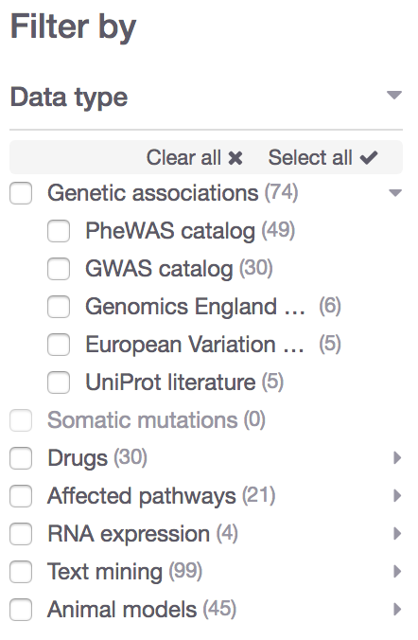
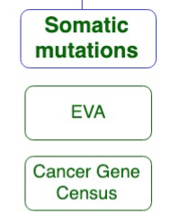
Data sources grouped into data types
19.04
Data type
Data source
https://docs.targetvalidation.org/data-sources/data-sources

Slide 20

What can you do with the Open Targets Platform?
Target-disease associations (+ evidence + score)
https://www.targetvalidation.org/evidence/ENSG00000141510/EFO_0000228
Target annotations
http://www.targetvalidation.org/target/ENSG00000141510
Disease annotations
http://www.targetvalidation.org/diseaset/EFO_0000228

Slide 21
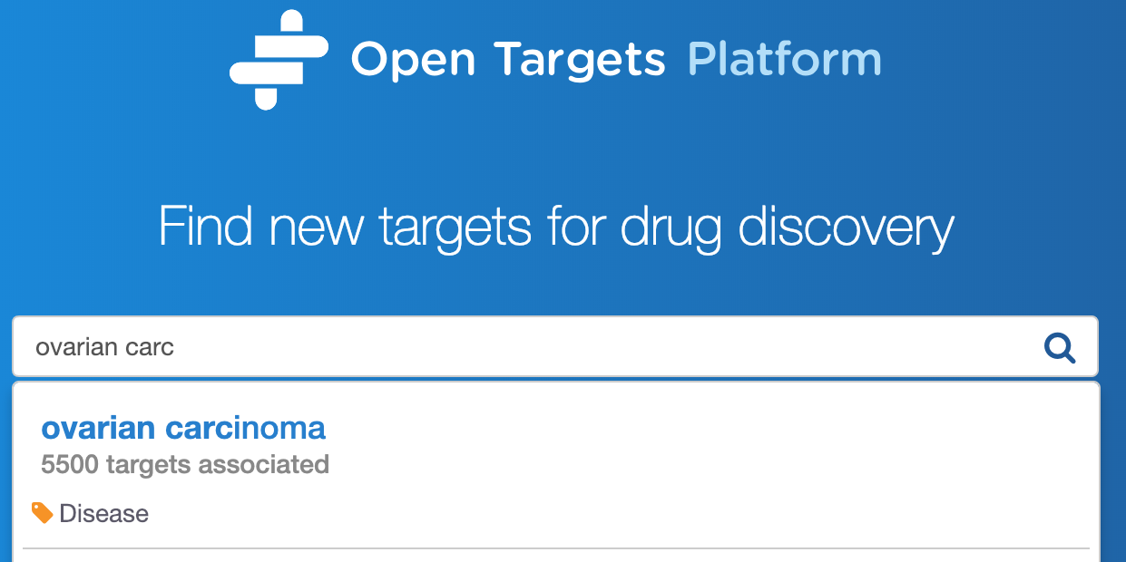
Demo 1: Disease centric workflow
Which targets are
associated with a disease?
https://tinyurl.com/exercises-STORM
Pages 7-15
Is there any data to help me to prioritise some targets?
What is the evidence for the association?

Slide 23
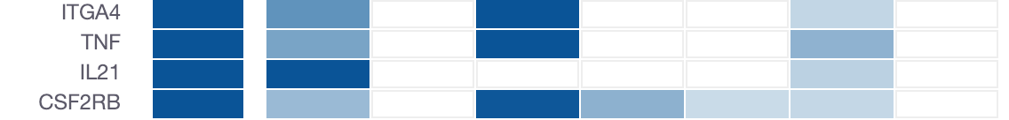
Association score
Which targets have more evidence for an association with a disease?
What is the relative weight of the evidence for different targets?
Overall score
Genetic
Somatic
Drugs
Pathways
Expression
Text mining
Animal mod

Slide 24
Four-tier scoring framework
Statistical integration, aggregation and scoring
1) Evidence score (e.g. one SNP from a GWAS paper)
2) Data source score (e.g. all SNPs from the GWAS catalog)
3) Data type score (e.g. all sources of Genetic associations)
4) Overall association score
https://docs.targetvalidation.org/getting-started/scoring

Slide 25

Step 1: evidence score
score = f * s * c
f, relative occurrence of a target-disease evidence
s, strength of the effect of the variant
c, confidence of the observation for the target-disease evidence
f = sample size (cases and controls)
s = predicted functional consequence (VEP)
c = p value reported in the paper
(Factors affecting the relative strength of GWAS Catalog evidence)
https://docs.targetvalidation.org/getting-started/scoring

Slide 26
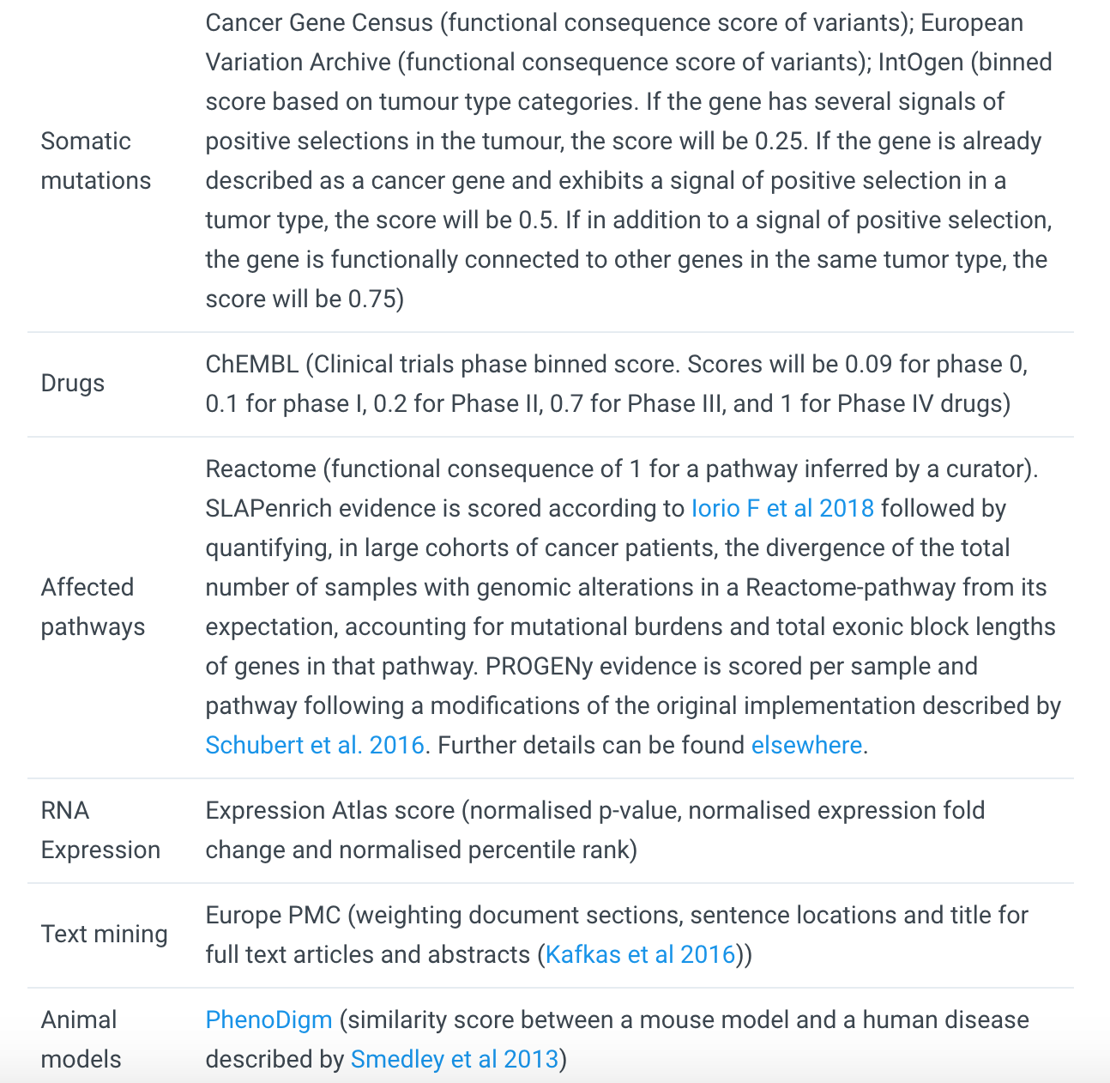
e.g. score for microarray and RNASeq evidence =
normalised (p_value) * (percentile rank) * (log_fold_change)/10)
https://docs.targetvalidation.org/getting-started/scoring
Factors affecting the relative strength of the evidence

Slide 27
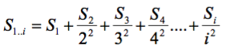
Aggregating scores across the data
Using a mathematical function, the harmonic sum*
where S1,S2,...,Si are the individual sorted evidence scores in descending order
Advantages:
A) account for replication
B) deflate the effect of large amounts of data e.g. text mining
* PMID: 19107201, PMID: 20118918

Slide 28
Aggregating scores
Σ_{H}
*1.0
Genomics England
Score: 0 to 1 (max)
Σ_{H}
*1.0
PheWAS catalog
Σ_{H}
*1.0
European Variation Archive (germline)
Σ_{H}
*1.0
Σ_{H}
Genetic associations
Calculated at four levels:
Evidence
Data source
Data type
Overall
UniProt
Σ_{H}
*1.0
Gene2Phenotype
Σ_{H}
*1.0
GWAS catalog
Σ_{H}
*1.0
Cancer Gene Census
Σ_{H}
*1.0
European Variation Archive (somatic)
Σ_{H}
Somatic mutations
Σ_{H}
*1.0
IntOGen
Aggregation with (harmonic sum)
Σ_{H}
Σ_{H}
*1.0
ChEMBL
Drugs
Σ_{H}
*1.0
Reactome
Note: Each data set has its own scoring and ranking scheme
Σ_{H}
*0.5
SLAPenrich
Σ_{H}
*0.5
Σ_{H}
Pathways &
systems biology
PROGENy
Σ_{H}
*0.5
Sysbio
Σ_{H}
*0.2
Expression Atlas
RNA expression
Σ_{H}
*0.2
Europe PMC
Text mining
Σ_{H}
*0.2
PhenoDigm
Animal models
weight factor
Σ_{H}
S₁ + S₂/2² + S₃/3² + S₄/4² + S_{i}/i²
Σ_{H}
Association

Slide 29
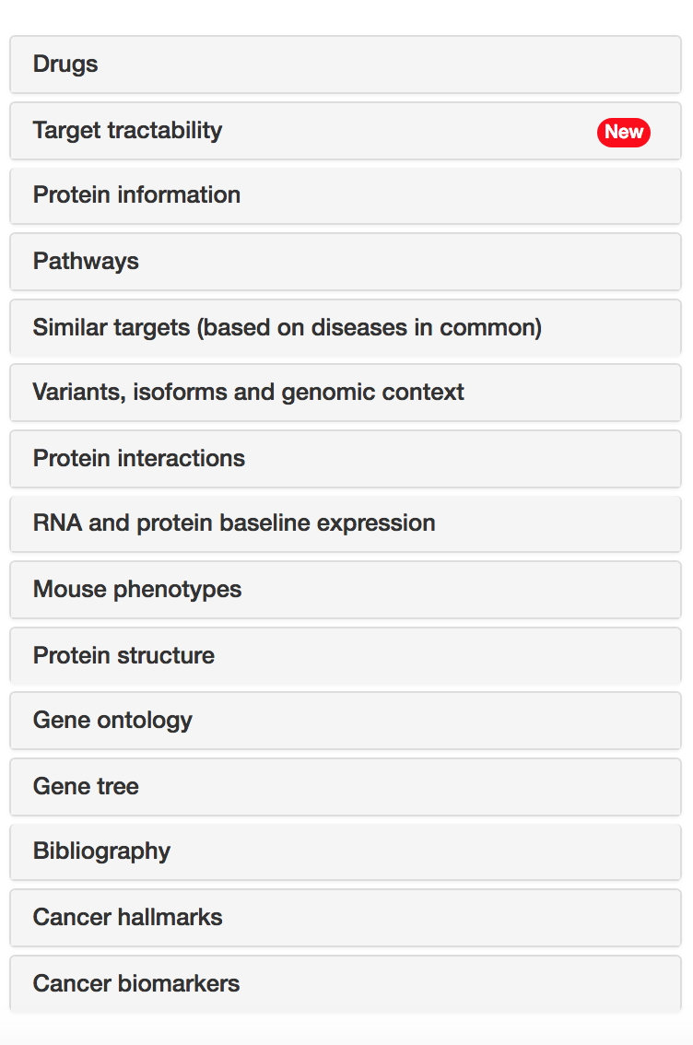
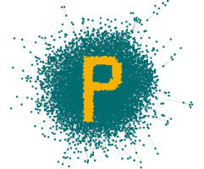










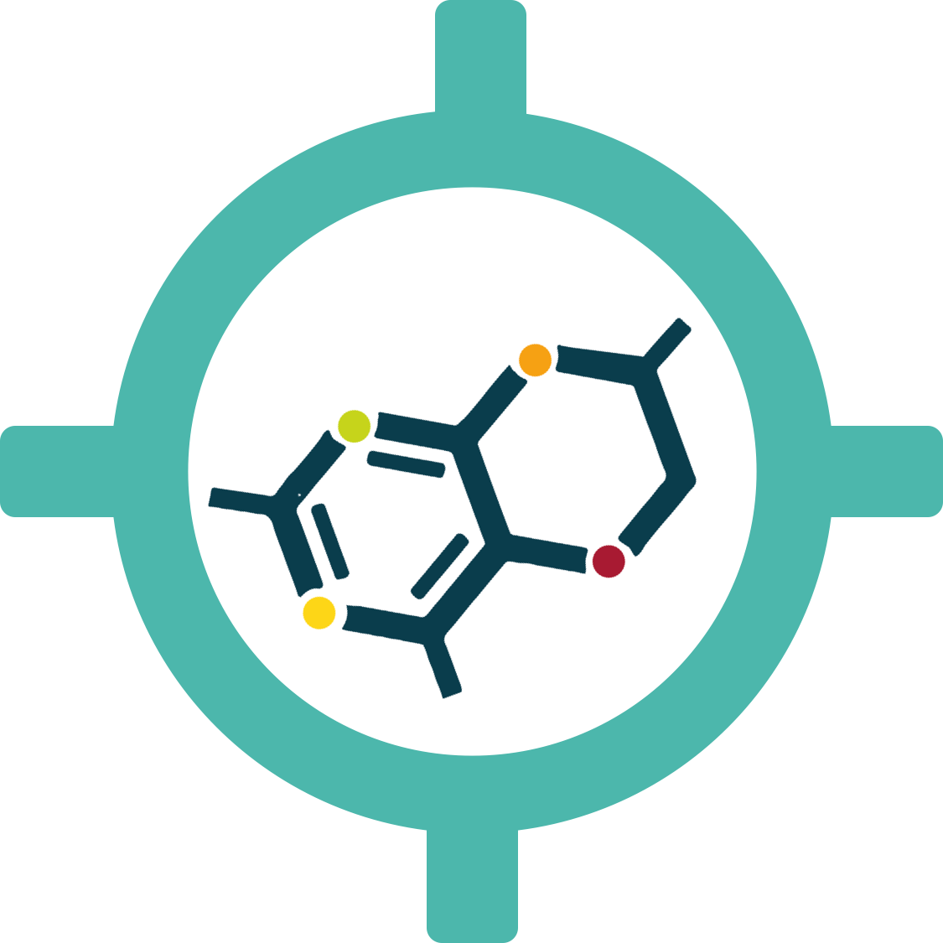




Target annotations
Target
profile page
https://docs.targetvalidation.org/getting-started/getting-started/target-profile

Slide 30
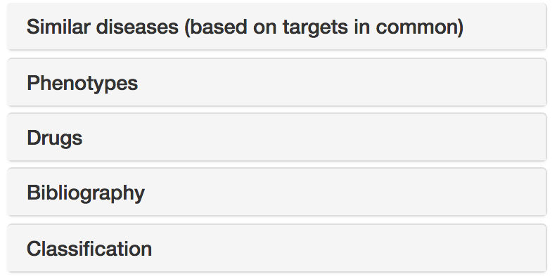


Disease annotations
Disease profile page
https://docs.targetvalidation.org/getting-started/getting-started/disease-profile

Slide 31
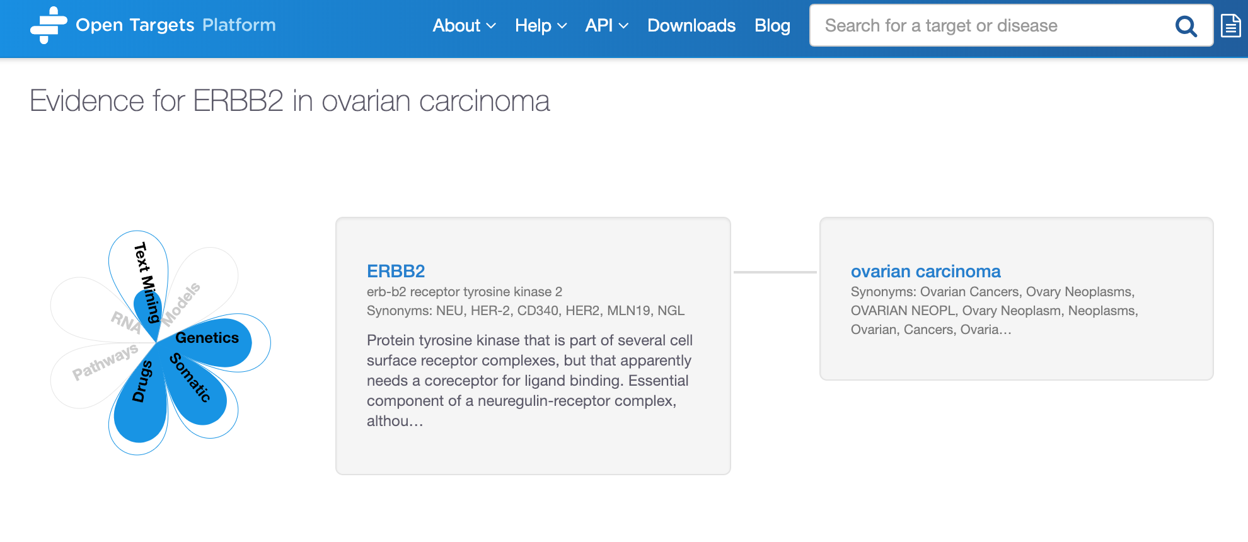
Demo 2: Annotations of targets/diseases
What is the information available for my target?
Target
profile page
Disease profile page
What can I find about a disease?
https://tinyurl.com/exercises-STORM
Pages 15-21

Slide 33
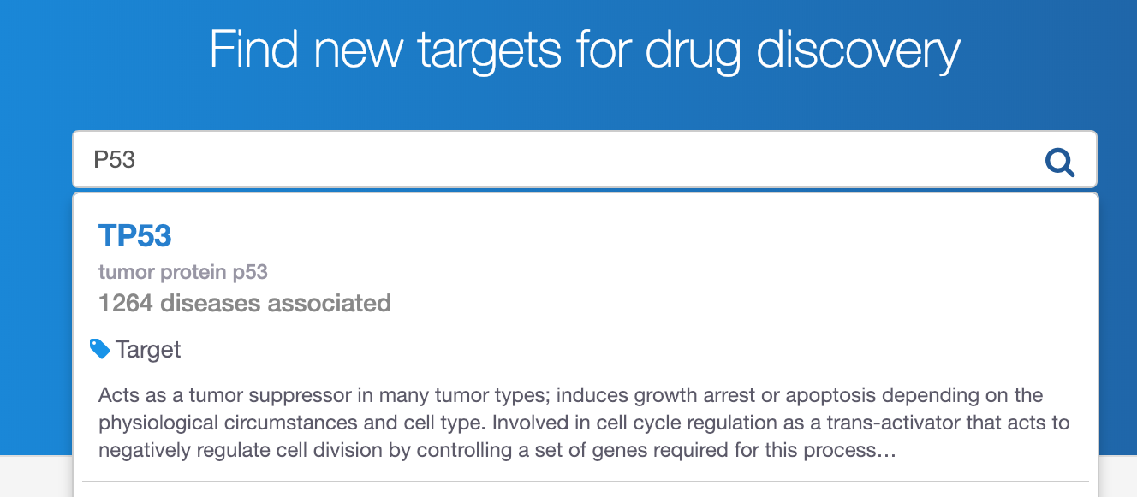
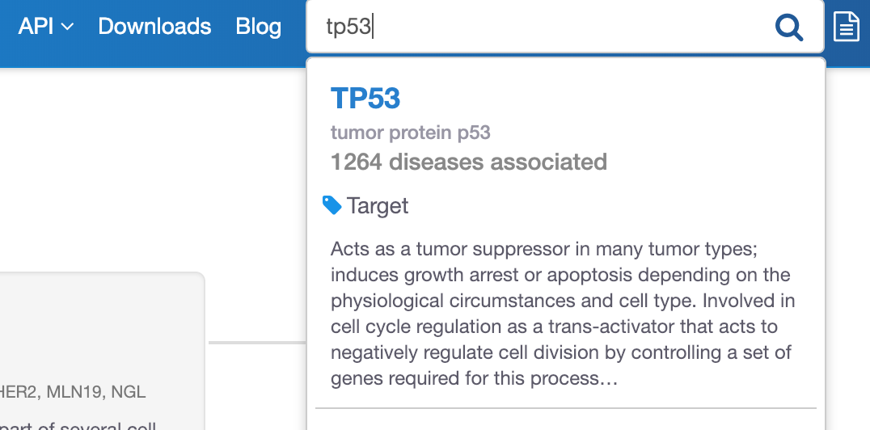
Demo 3: Target centric workflow
Which diseases are
associated with my target?
https://tinyurl.com/exercises-STORM
Pages 21-24

Slide 36
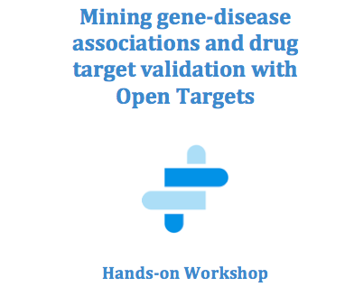
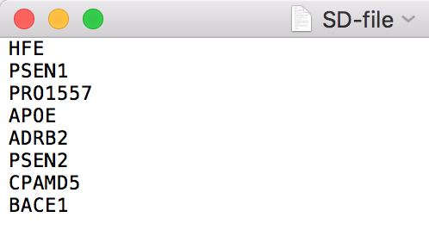
Hands-on exercises 1, 2, 3
Pages 25-27
Or feel free to explore your target (gene/protein) and disease of interest
https://tinyurl.com/exercises-STORM

Slide 37
Extra hands-on exercises E1-E3
Pages 28-30
Or feel free to explore your target (gene/protein) and disease of interest
https://tinyurl.com/exercises-STORM

Slide 38
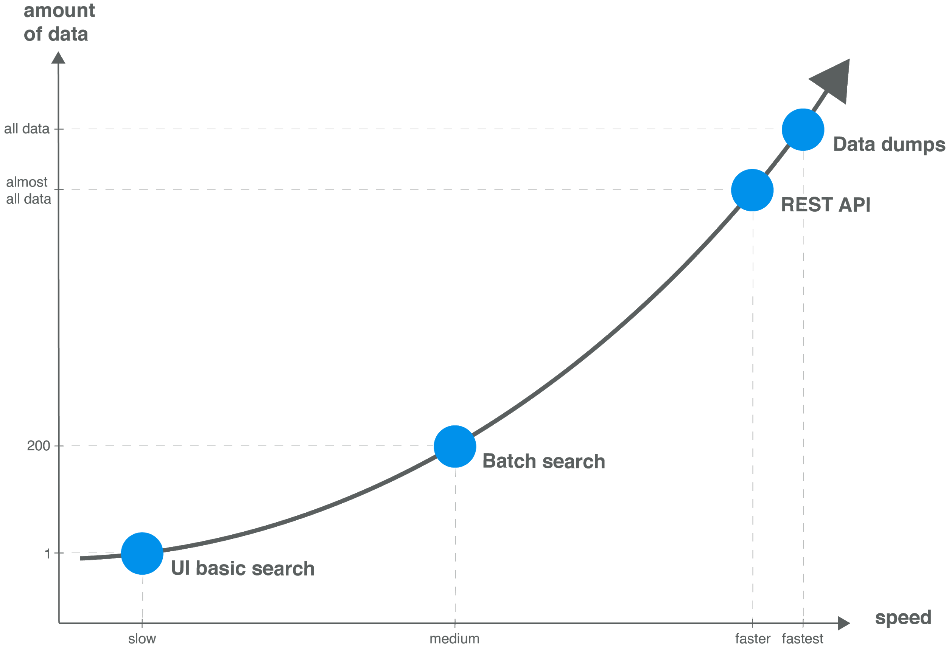
Modes of access → data volume

Slide 39
Demo 4: Several targets at once
We have a list of 20 possible targets for multiple myeloma.
Are these targets represented in other diseases?
Which pathways are represented in this set of
targets?
https://www.targetvalidation.org/batch-search

Slide 41




Open Targets Platform REST API*
Server
https://platform-api.opentargets.io/v3/platform/
Endpoint
public/association/filter
Parameters
?target=ENSG00000163914&size=10000&fields=target.id&fields=disease.id
Open Targets Python client **
*
https://docs.targetvalidation.org/tutorials/rest-api
**
https://docs.targetvalidation.org/tutorials/python-client

Slide 42
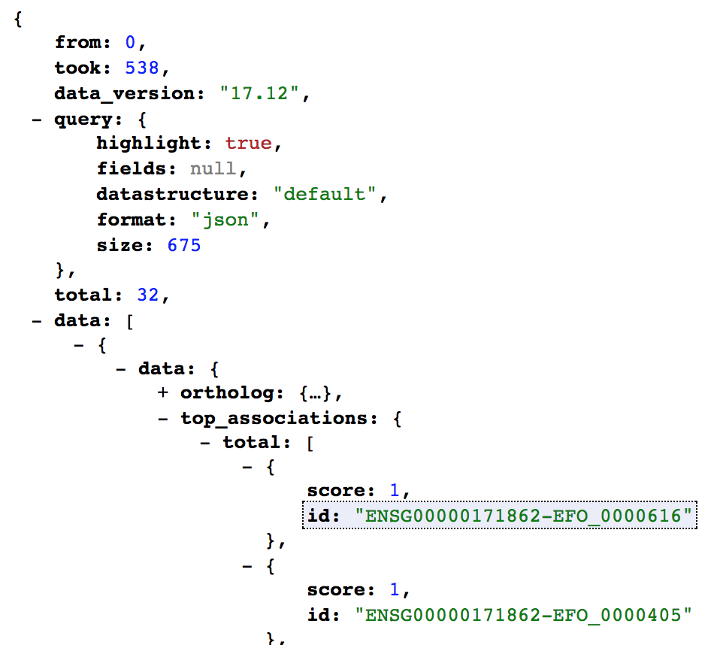
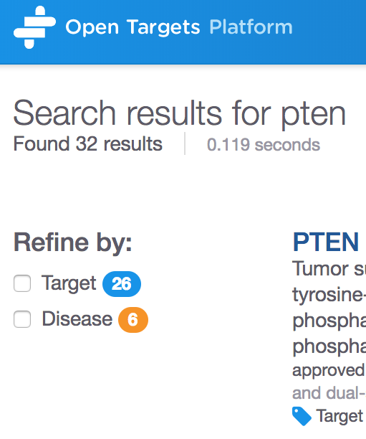
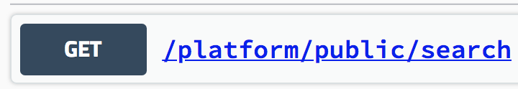
How to search
https://platform-api.opentargets.io/v3/platform/public/search?q=PTEN

Slide 43
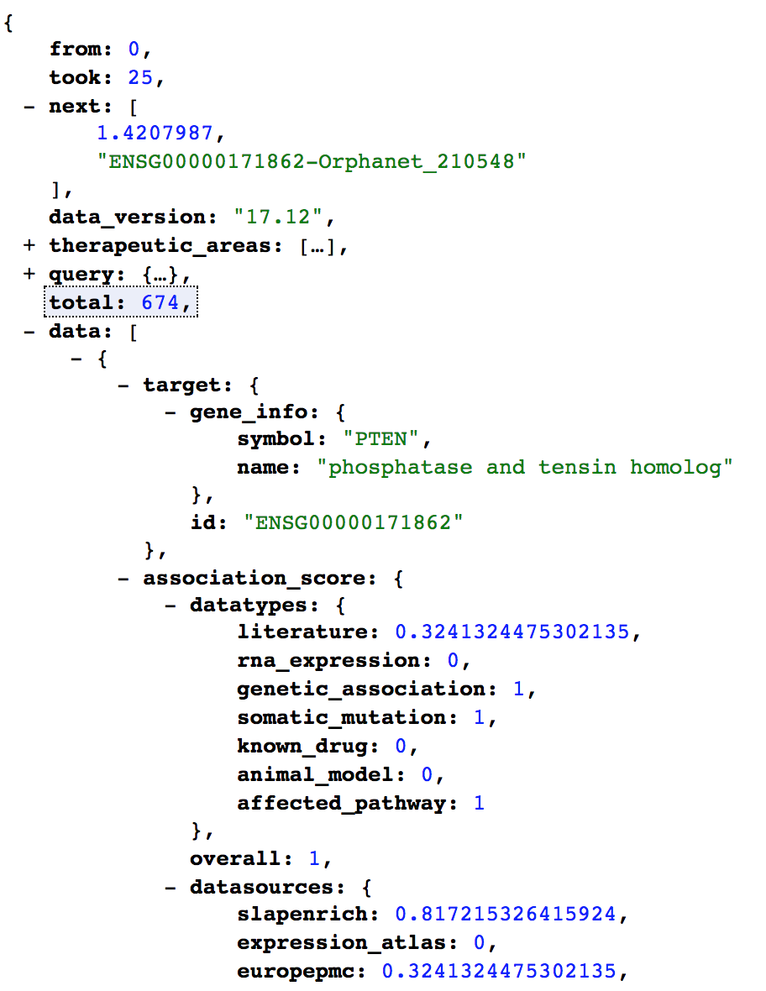
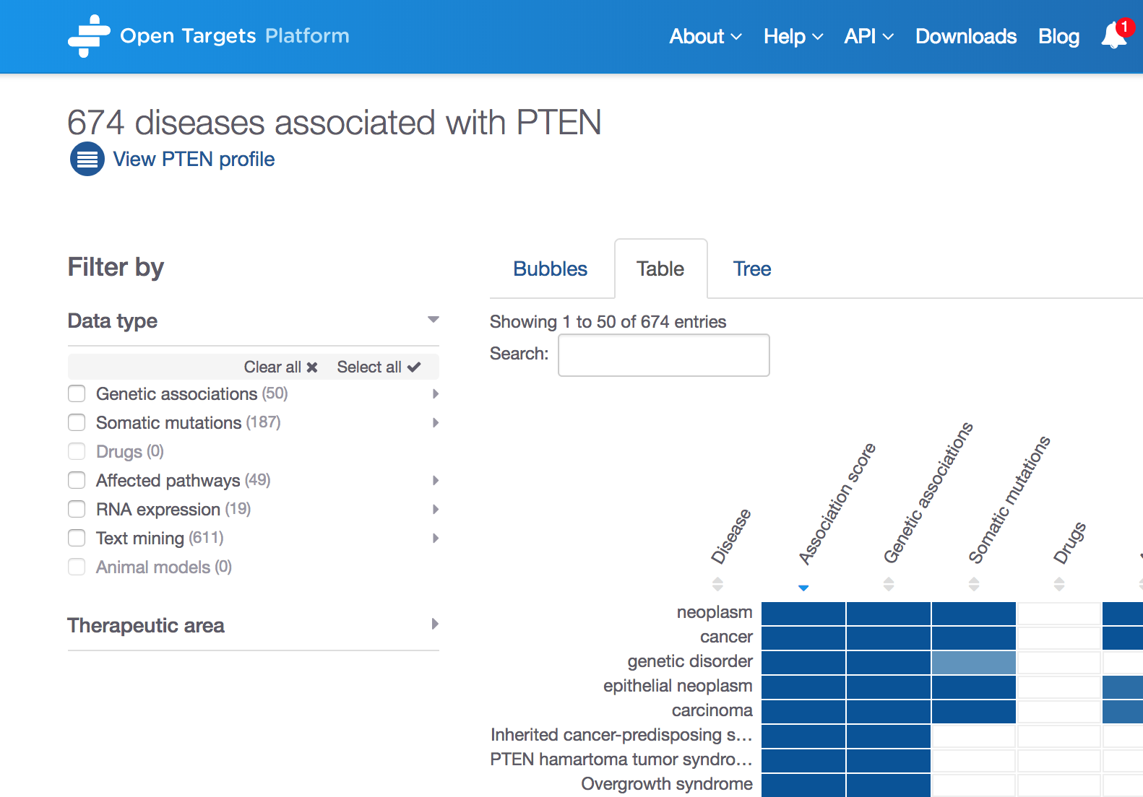
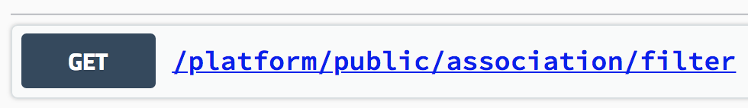
How to get all diseases associated with a target
http://platform-api.opentargets.io/v3/platform
/public/association/filter?
target=ENSG00000171862
&direct=true

Slide 44
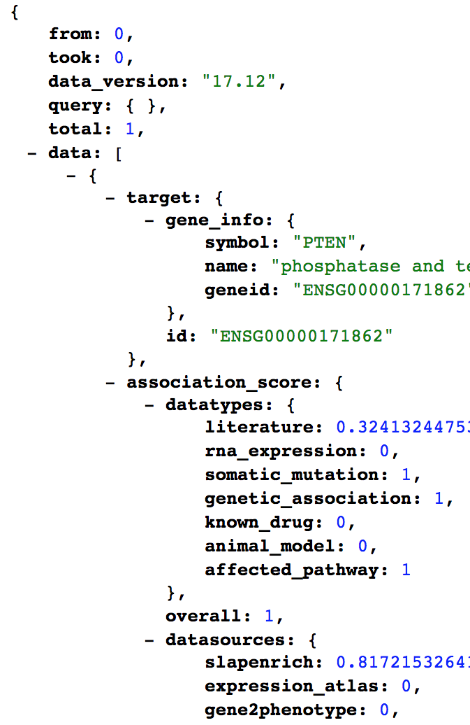
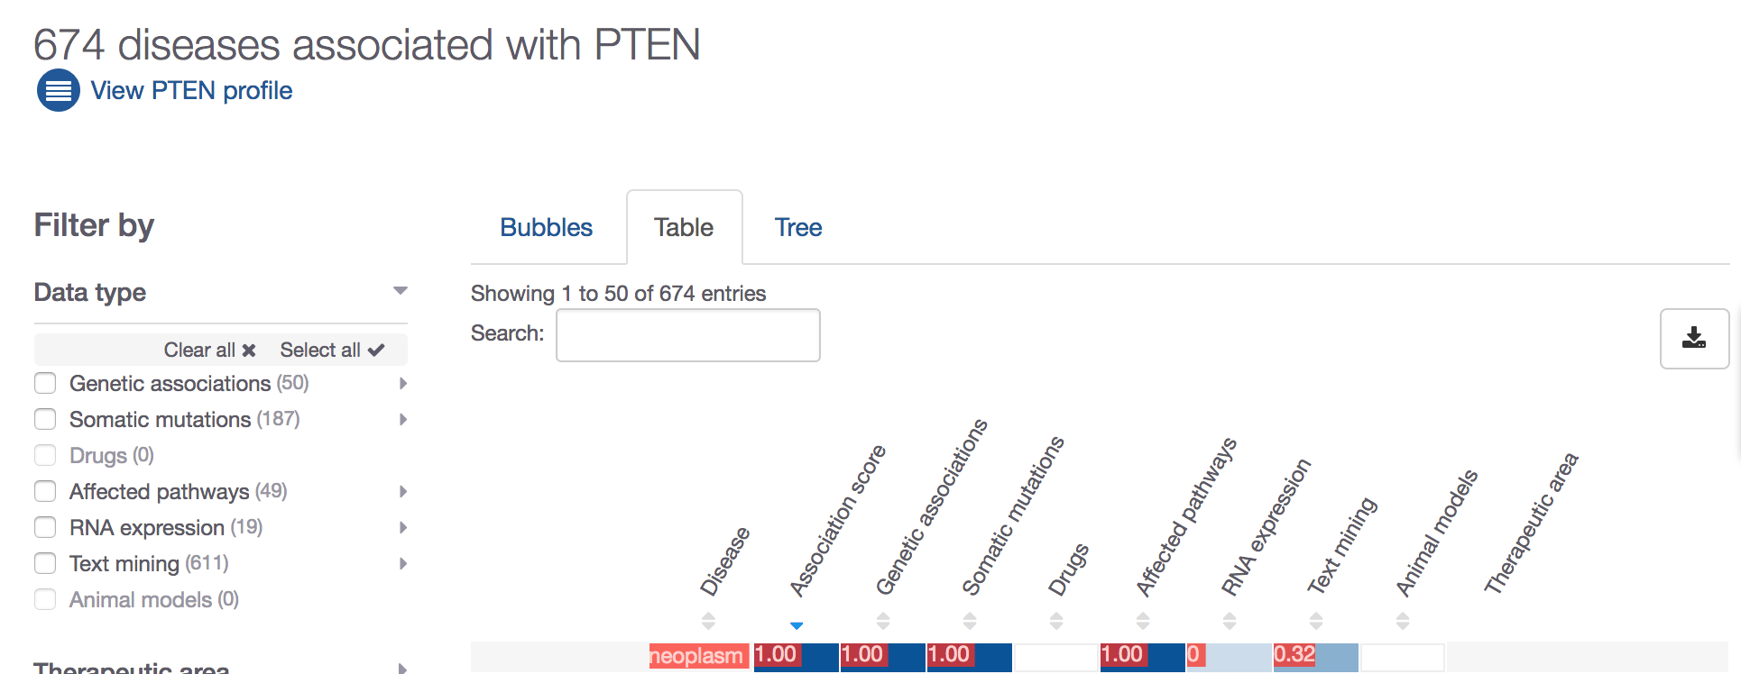
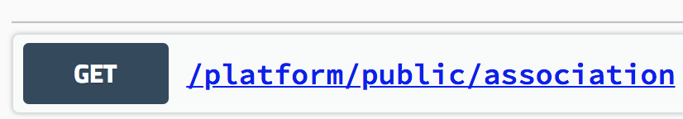
How to get the score for an association
http://platform-api.opentargets.io/v3/platform/
public/association?id=ENSG00000171862
-EFO_0000616
Notes:
http://platform-api.opentargets.io/v3/platform/public/association?id=ENSG00000171862-EFO_0000616
http://platform-api.opentargets.io/v3/platform/public/association/filter?target=ENSG00000171862

Slide 45
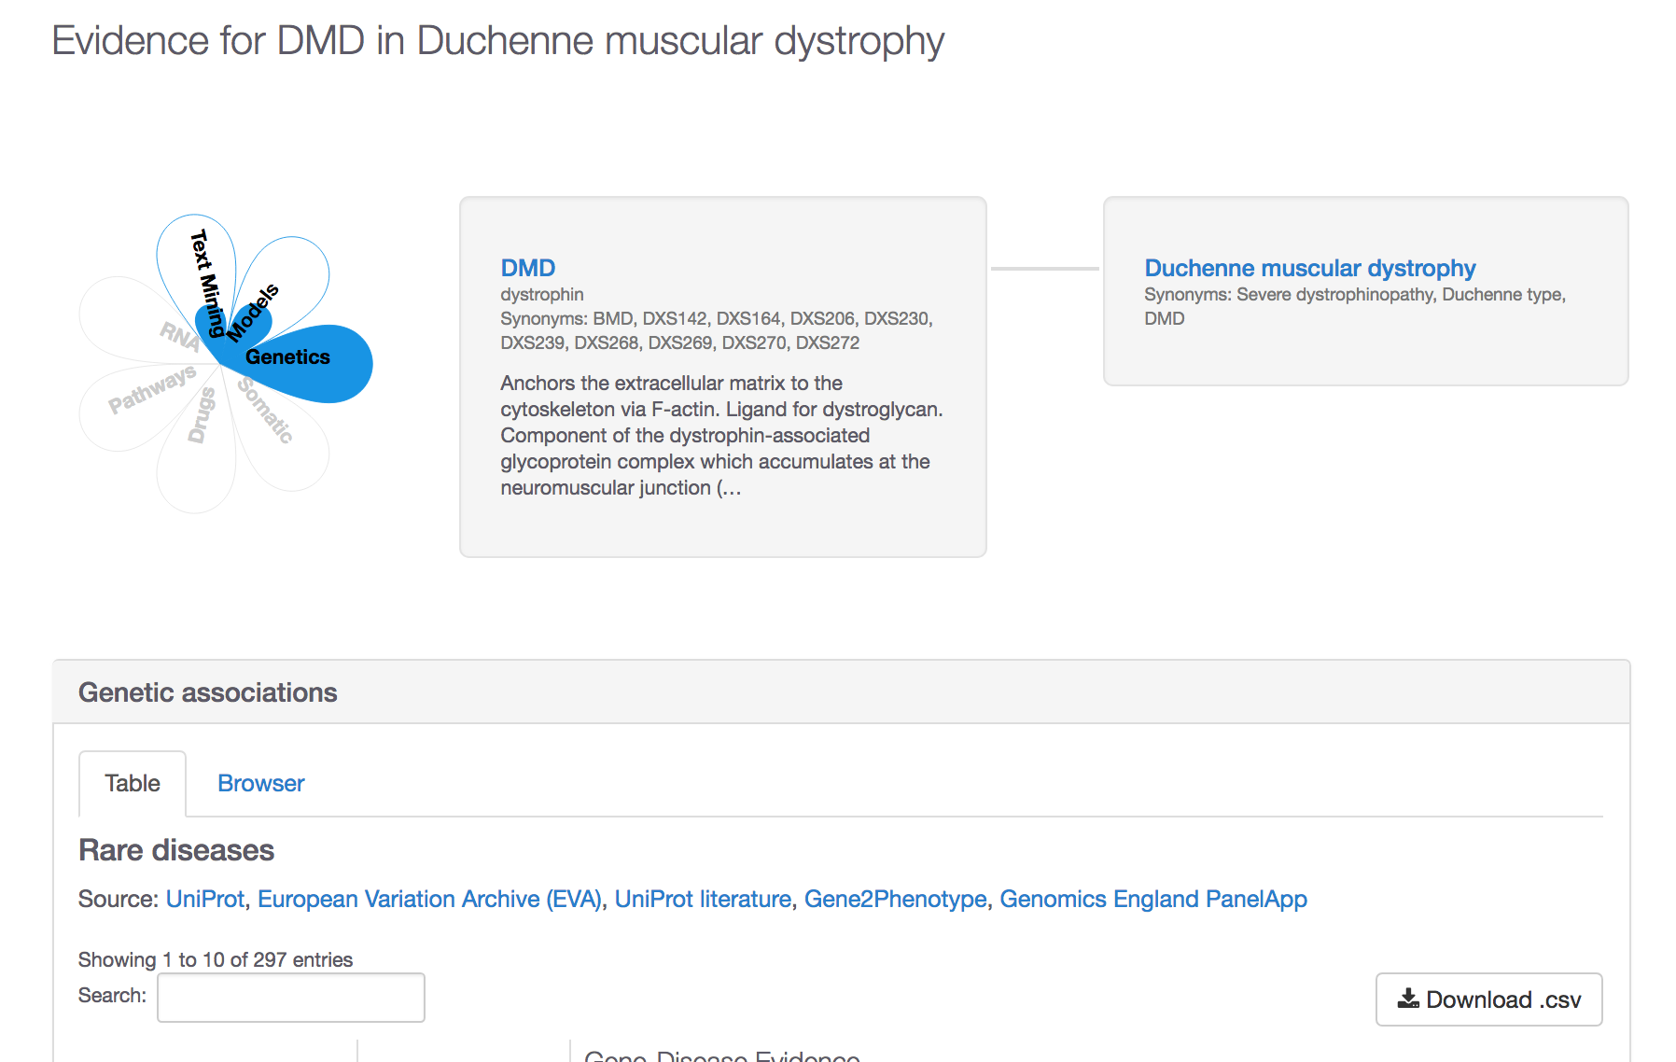
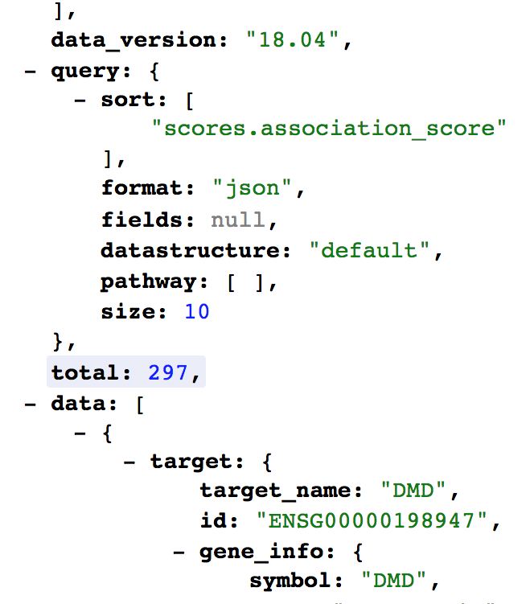
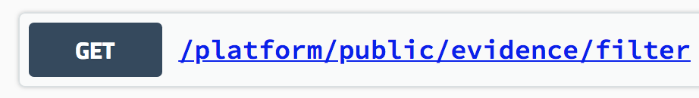
How to get the evidence for an association
http://platform-api.opentargets.io/v3/platform/public/evidence/filter?target=ENSG00000198947&disease=Orphanet_98896&datatype=genetic_association

Slide 46
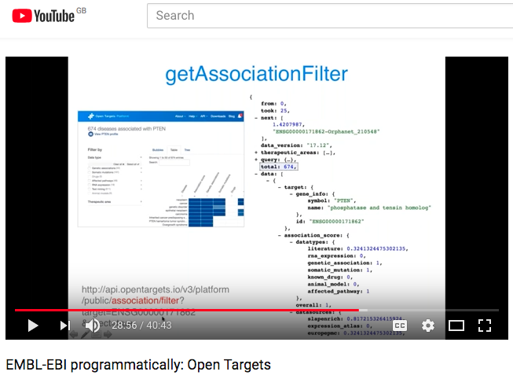
REST API
https://docs.targetvalidation.org/tutorials/rest-api
https://youtu.be/KQbfhwpeEvc

Slide 47
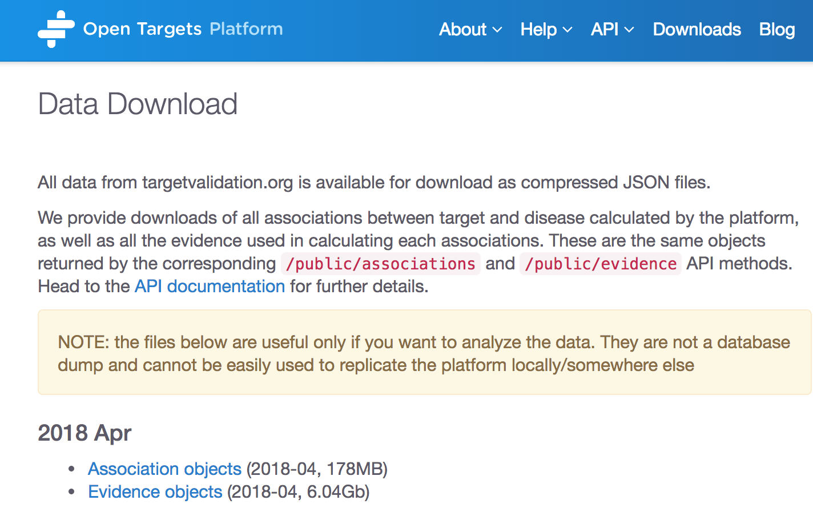
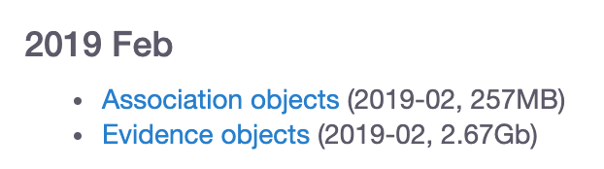
Data downloads

Slide 48
Extra hands-on exercises E4-E5
Pages 30-31
Or feel free to explore your target (gene/protein) and disease of interest
https://tinyurl.com/exercises-STORM

Slide 49
Data integration: Open Targets
Open Targets Platform | Open Targets Genetics
Dec 2015 | Oct 2018
www.targetvalidation.org | genetics.opentargets.org
Targets, diseases and drugs | Variant, targets and diseases
Score that synthesises all evidence for T-D | Score that connects T-D via functional evidence
Rare and common diseases | Common diseases, other traits

Slide 50
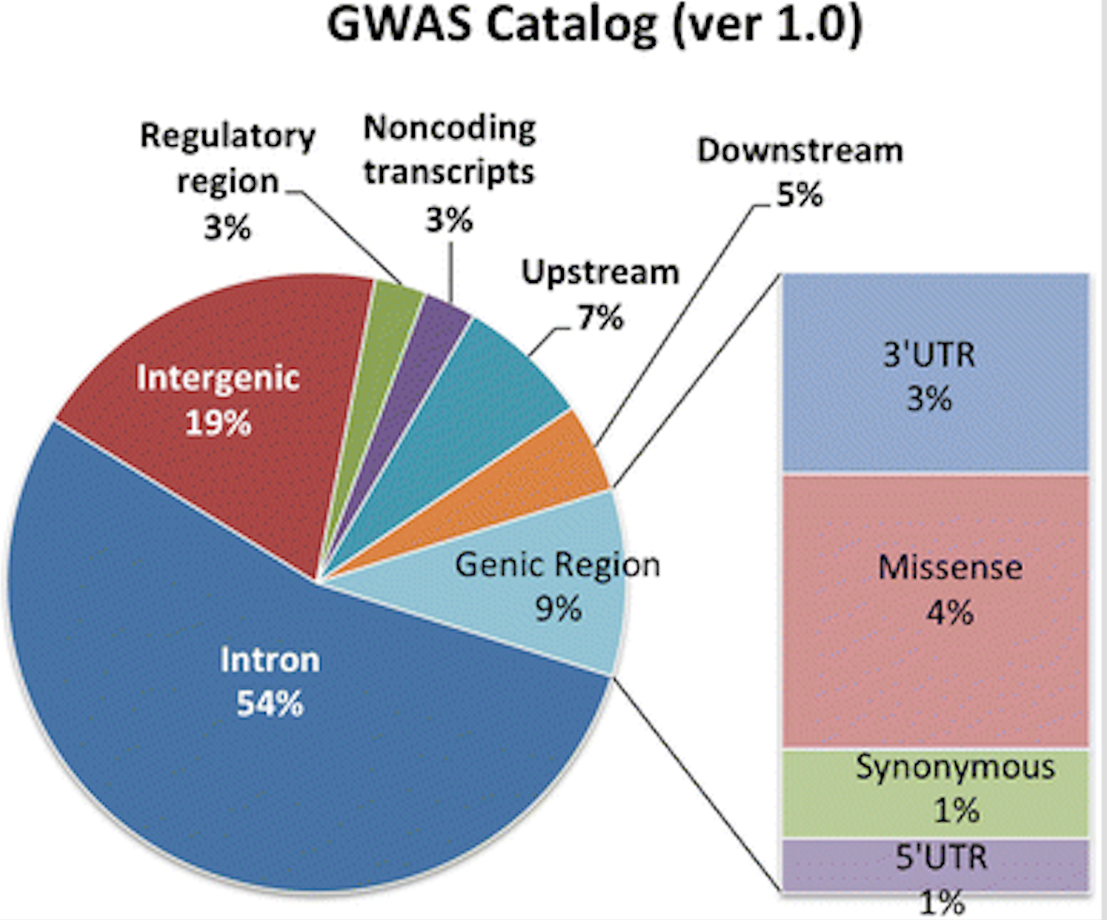
Open Targets Genetics. Why?
Refine our genetic associations
Make sense of GWAS
Glimpses of the biology behind the association
Guide target ID?
Lee et al (2017): PMID:29288389
Notes:
Mechanism behind GWAS signal…
Improve map of GWAS signal and gens (behind)

Slide 51

Key question
Which targets are implicated in disease from common variant genetics analysis?
https://genetics.opentargets.org

Slide 52






Open Targets Genetics: data sources
Genetics
Variant (GnomAD) – Trait (study)
Functional Genomics
Variant – Gene
Sun et al. 2018
*
**
***
SNP-trait
associations
Full summary statistics
Neale and colleagues v1
337,199 individuals
2,419 traits
Ensembl
VEP
* Javierre et al. 2016
** Andersson et al. 2014
*** Thruman et al. 2012
https://genetics-docs.opentargets.org/our-approach/data-sources
Notes:
Data with summary stats→ fine mapping
Data with no summary stats → LD
More associations in Genetics than PostGAP (plus additional data pQTLs)

Slide 53
Open Targets Genetics: data model
r²
Posterior Prob.
Aggregated functional score
S
p-value
V_{L}
V_{T}
G
GWAS Catalog
UK Biobank
Fine mapping
LD expansion
TSS distance
eQTL (GTEx V7)
pQTL
PCHI-C
FANTOM5
VEP
S Study (traits from UK Biobank and GWAS catalog)
V_{L} Lead variant (associated with traits from GWAS catalog)
V_{T} Tag variant (possible causal, expanded from V_{L})
G Gene
https://genetics-docs.opentargets.org/our-approach/pipeline-overview

Slide 54
What can you do with Open Targets Genetics?
V
S
G
Variant
Trait
Gene
Genes functionally implicated
Variant association across traits (PheWAS)
Variants tagged
Independently associated loci
Overlapping susceptibility loci
Associated traits
Links to drugs, expression, pathway, mouse phenotype, etc in Open Targets Platform
Locus plot
Visualising the associations between traits, variants, and genes
Fine mapping analysis

Slide 55

Small cell lung carcinoma
Notes:
The locus view starts from a lead variant and expand to other variants (LD and fine mapping), hence connecting to more genes than available in the assigned gene table.
The Locus Plot only shows pieces of evidence that span all the way from S-VL-VT-G, so won’t be shown if there is no functional evidence linking to a gene.

Slide 56




Open Targets Genetics: data access
GraphQL API
Bulk download*
http://genetics-api.opentargets.io/
* http://blog.opentargets.org/2019/04/09/open-targets-genetics-release-is-out/

Slide 57



Rheumatoid arthritis (RA) and IL6R
Open Targets Platform
Open Targets Genetics
https://genetics.opentargets.org/variant/1_154426970_A_C
Notes:
The assigned gene table in Genetics shows the genes for where a variant X is associated with based on the functional data (QTLs and chromatin interactions)

Slide 58
Wrap up
Public data
Experimental projects
Bioinformatics projects
DATA
GENERATION
DATA
INTEGRATION
Therapeutic hypothesis
https://www.targetvalidation.org
https://genetics.opentargets.org
Notes:
Target ID and prioritisation knowledge cycle.
Our research focusses on data generation, data integration, and enabled data access
Our research is connected as we provide the tools to generate hypothesis and explore them experimentally
We focus primarily on oncology, immunology (including IBD) neurodegeneration with some experiments in other areas or across diseases

Slide 59


How to cite us
http://bit.ly/cite-us

Slide 60




Get in touch
Open Targets Platform | Open Targets Genetics
docs.targetvalidation.org | genetics-docs.opentargets.org
support@targetvalidation.org | geneticsportal@opentargets.org
@targetvalidate
blog.opentargets.org/
http://tinyurl.com/opentargets-in
https://tinyurl.com/opentargets-youtube

Slide 61










Acknowledgements

Slide 62
Your feedback is important
https://tinyurl.com/storm-300419
Notes:
https://tinyurl.com/cam-120618

Slide 63
Extra extra extra
Details on data sources to associate
targets and diseases
Other Open Targets resources

Slide 64






Data sources: GWAS catalog
Genome Wide Association Studies
Array-based chips → genotyping 100,000 SNPs genomewide

Slide 65


Data sources: UniProt
Protein: sequence, annotation, function
Manual curation of coding variants in patients
EMBL-EBI train online

Slide 66

Data sources: Gene2Phenotype
Variants, genes, phenotypes in rare diseases
Literature curation → consultant clinical geneticists in the UK

Slide 67
Data sources: UniProt
Protein: sequence, annotation, function
Manual curation of coding variants in patients
EMBL-EBI train online

Slide 68

Data sources: PheWAS
Phenome Wide Association Studies
A variant associated with multiple phenotypes
Clinical phenotypes derived from EMR-linked biobank BioVU
ICD9 codes mapped to EFO

Slide 69

Data sources: GE PanelApp
Aid clinical interpretation of genomes for the 100K project
We include ‘green genes’ from version 1+ and phenotypes

Slide 70

Data sources: EVA
With ClinVar information for rare diseases
Clinical significance: pathogenic, protective
EMBL-EBI train online

Slide 71

Data sources: The Cancer Gene Census
Genes with mutations causally implicated in cancer
Gene associated with a cancer plus other cancers associated with that gene

Slide 72

Data sources: IntOGen
Genes and somatic (driver) mutations, 28 cancer types
Involvement in cancer biology
Rubio-Perez et al. 2015
Notes:
Somatic mutations from cancer drivers genes across 28 tumor types. We have imported data (2014.12) from 6,792 samples spanning 28 cancer types (Rubio-Perez et al)."

Slide 73

Data sources: ChEMBL
Known drugs linked to a disease and a known target
FDA approved for clinical trials or marketing
EMBL-EBI train online

Slide 74

Data sources: Reactome
Biochemical reactions and pathways
Manual curation of pathways affected by mutations
EMBL-EBI train online

Slide 75

Data sources: SLAPenrich
374 pathways curated and mapped to cancer hallmarks
Divergence of the total number of cancer samples with genomic alterations
Mutational burden and total exonic block length of genes
Downweighed
Notes:
25 tumour types
Statistical framework for the identification of significantly mutated pathways
https://docs.targetvalidation.org/data-sources/affected-pathways#slapenrich

Slide 76

Data sources: PROGENy
Comparison of pathway activities between normal and primary samples from The Cancer Genome Atlas
Inferred from RNA-seq: 9,250 tumour and 741 normal samples
EGFR, hypoxia, JAK.STAT, MAPK, NFkB, PI3K, TGFb, TNFa, Trail, VEGF, and p53
Downweighed
Notes:
Linear regression model-from 14 tumour types.
https://docs.targetvalidation.org/data-sources/affected-pathways#progeny

Slide 77
Data sources: SysBio
Curation of four systems biology papers
Available for six gene lists: ~ 400 genes
Late onset Alzheimers, cognitive decline, CHD, and IBD
Score: p-values or rank-based scores if available, otherwise 0.5 is assigned
Downweighed
Notes:
key drivers (or regulators) 4 diseases/phenotype
https://docs.targetvalidation.org/data-sources/affected-pathways#sysbio

Slide 78

Data sources: Expression Atlas
Baseline expression for human genes
- target profile page
Differential mRNA expression (healthy versus diseased):
- target-disease associations
Downweighed
EMBL-EBI train online

Slide 79

Data sources: Europe PMC
Mining titles, abstracts, full text in research articles
Target and disease co-occurrence in the same sentence
Dictionary (not NLP)
Downweighted
EMBL-EBI train online

Slide 80

Data sources: PhenoDigm
Semantic approach to associate mouse models with diseases
Similarity score between a mouse model and a human disease (Smedley et al 2013)
Downweighted

Slide 81






Target-Disease Association Score
EuropePMC
(Text Mining)
UniProt
(Manual Curation)
Overall
ChEMBL
(Manual Curation)
VERY simplified diagram

Slide 82

How to run our REST endpoints (option 1)
Paste the URL in the location bar of your browser

Slide 83



Slide 84

How to run our REST endpoints (option 2)
Command line e.g. CURL –X GET

Slide 85

How to run our REST endpoints (option 3)
Use our free Python client *
Advantage: you can change the way the associations are scored e.g. increase the weight given to text mining data
* https://docs.targetvalidation.org/tutorials/python-client

Slide 86


User interface or REST API?
Scale and volume of your search or results
Flexibility in the search
Visualisation of the results
Notes:
http://api.opentargets.io/v3/platform/public/evidence?id=d0ad72d0e798449346de04eb3b189e10

Slide 87



REST API calls: some examples*
https://platform-api.opentargets.io/v3/platform/public/search?q=alzheimer%27s
https://platform-api.opentargets.io/v3/platform/public/association/filter?target=ENSG00000142192
https://platform-api.opentargets.io/v3/platform/public/association/filter
?target=ENSG00000142192&direct=true
https://platform-api.opentargets.io/v3/platform/public/evidence/filter?target=ENSG00000142192&disease=EFO_0000249&datasource=uniprot&direct=true

Slide 88

Open Targets REST API
https://platform-api.opentargets.io/v3/platform/docs/swagger-ui
Private: methods used by the UI to serve external data. Subject to change without notice

Slide 89
REST API: webinar
https://youtu.be/KQbfhwpeEvc

Slide 90

LINK
http://link.opentargets.io/
LINK: Literature coNcept Knowledgebase
Subject / predicate / object structured relations
From PubMed abstracts
Proof of Concept
Further developement

Slide 91


Addressing text mining shortcomings
Entities: genes, diseases, drugs
Concepts extracted via NLP (Natural Language Processing)
28 M documents, 500 M relations
http://blog.opentargets.org/link/

Slide 92

DoRothEA
dorothea.opentargets.io
Candidate TF-drug interactions in cancer
1000 cancer cell lines
265 anti-cancer compounds
127 transcription factors
http://cancerres.aacrjournals.org/content/early/2017/12/09/0008-5472.CAN-17-1679

Slide 93


Example: Rapamycin
~ 1000 cancer cell lines
265 anti-cancer compounds
127 transcription factors

Slide 94


CELLector
http://blog.opentargets.org/2019/02/04/looking-for-cell-line-models-to-predict-anticancer-drug-response-in-patients-cellector-can-help-you/

Slide 95
Variant-to-Gene Assignment
Data type
Feature
(tissue/cell)
V₁G₁ … … … V_{M}G_{N}
Source
Weighted by source
QTL
eQTL
44 tissues
×0.6
Gene expression
pQTL
Blood
×0.6
PCHi-C
17 cells
×0.3
Interaction
Enhancer-TSS
NA
×0.3
DHS-promoter
NA
In Silico
Functional
Prediction
Variant Effect
Predictor (VEP)
NA
×0.3
×1.0
Quantile
transformation
(within tissues)
Variant-Gene
annotation
Aggregate across tissues
(max score across tissues -> per-source V2G score)
Aggregate across functional genomics studies
(mean weighted-score -> overall V2G score)
https://genetics-docs.opentargets.org/our-approach/data-pipeline
Notes:
Make it clear that anything with a none-zero score is “significant”
Colocalisation will be added
Currently all functional data is used to calculate aggregated scores, we want to get to a place where you can set up a configuration which allows functional datasets specific to your therapeutic area of interest to be calculated

